Slide 1
Law and Legal Institutions (LAWS8586)
Lectures 5-8

Slide 2
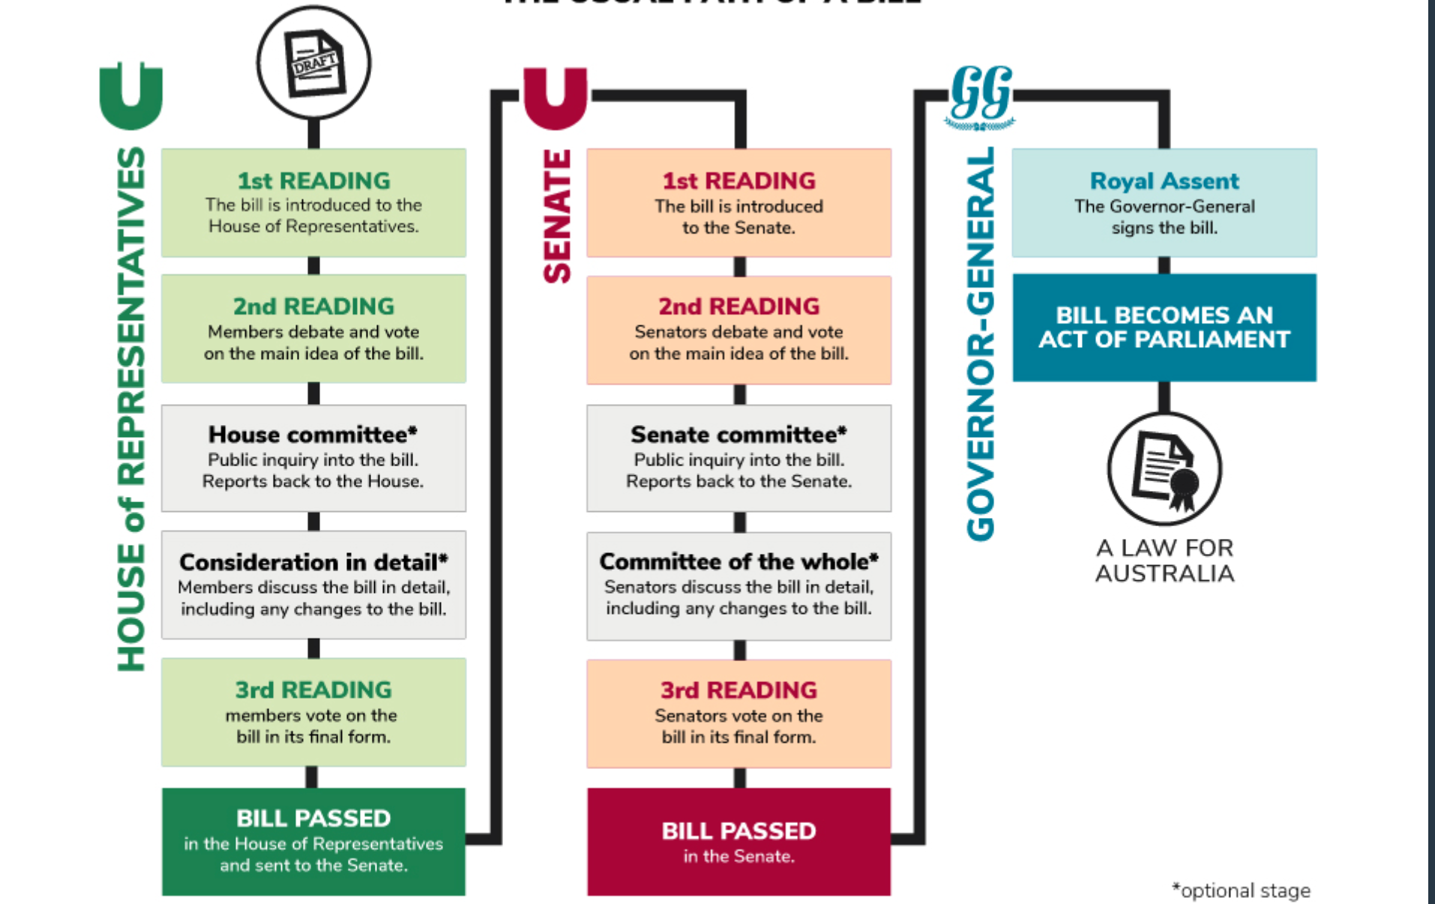
Passage of a Bill

Slide 3
Legislation
Increase in volume of legislation
Perceived benefits over case law
can be proactive rather than simply reactive
can bring about legal ‘U-turns’ (ie major law reform) with democratic legitimacy
can systematically regulate a vast area in painstaking detail (compared to case law) - expected of government in modern era and often warranted by pace of technological / social change
can be changed (arguably) more readily than case law - to amend or repeal existing legislation the very same process is used (i.e. it is another Act.)

Slide 4
Delegated legislation
Delegated (also known as subordinate) legislation is legislation made not directly by an Act of the Parliament, but under the authority of an Act of the Parliament.
Includes regulations, rules, by-laws, statutory instruments, ordinances.
Made according to process described in the enabling Act.
Not a ‘lesser’ form of law

Slide 5
Contextual approach
‘ordinary and natural’ meaning of the words
surrounding words/provisions, whole Act, dictionaries, maxims, presumptions, interpretations provided in previous cases, AIA, previous case law on the meaning of the words, existing state of the law
Acts Interpretation Act 1901

Slide 6
Purposive approach
Reading the Act or looking at the Common Law interpretation
Considering purpose might:
- confirm ordinary and natural meaning in context
- resolve ambiguity that existed on ordinary and natural meaning in context
- give rise to an ambiguity (ie a new meaning)

Slide 7
Project Blue Sky Inc v Australian Broadcasting Authority (1998) 194 CLR 355.
A legislative instrument must be construed on the prima facie basis that its provisions are intended to give effect to harmonious goals. Where conflict appears to arise from the language of particular provisions, the conflict must be alleviated, so far as possible, by adjusting the meaning of the competing provisions to achieve that result which will best give effect to the purpose and language of those provisions while maintaining the unity of all the statutory provisions. Reconciling conflicting provisions will often require the court to determine which is the leading provision and which the subordinate provision, and which must give way to the other… furthermore, a court considering a statutory provision must strive to give meaning to every word of the provision. (McHugh, Gummow, Kirby and Hayne JJ at 381–2).
However, the duty of a court is to give the words of a statutory provision the meaning that the legislature is taken to have intended them to have. Ordinarily, that meaning (the legal meaning) will correspond with the grammatical meaning of the provision. But not always (at 384).
An act done in breach of a condition regulating the exercise of a statutory power is not necessarily invalid and of no affect. Whether it depends upon whether there can be discerned a legislative purpose to invalidate any act that fails to comply with the condition… As ascertained by reference to the language of the statute, its subject matter and objects, and the consequences for the parties of holding void every act done in breach of the condition (at 388-9).

Slide 8
Maxims of interpretation
noscitur a sociis: a doctrine or rule of construction: the meaning of an unclear or ambiguous word (as in a statute or contract) should be determined by considering the words with which it is associated in the context.
ejusdem generis: Ejusdem generis is a Latin phrase that means “of the same kind.”
expressio unius est exclusio alterius: a rule of construction, applying both to statute and legal writings, that states that one thing having been mentioned the other is excluded.

Slide 9
Use of extrinsic materials
to confirm the ordinary and natural meaning of provision in light of context and purpose s 15AB(1)(a);
to determine the meaning of provision that is ‘ambiguous or obscure’ s 15AB(1)(b)(i); or
to determine the meaning of provision when ordinary and natural meaning in light of context and purpose ‘leads to a result that is manifestly absurd or is unreasonable’ s 15AB(1)(b)(ii)

Slide 10
Statutory interpretation
Find the ordinary and natural meaning of the provision when read in context (leading authorities for this basic principle of interpretation in context = Project Blue Sky and CIC Insurance Ltd v Bankstown Football Club Ltd (1997) 187 CLR 384).
maxims of interpretation assist contextual understanding
Find the legislative purpose by looking at the Act as a whole and attempt to read the provision in line with that purpose
Is it necessary or helpful to resort to extrinsic materials, per s 15AB AIA?

Slide 11
Judiciary
judiciary is independent from the other arms of government.
The separation of powers doctrine - in interpreting and applying the law, judicial officers act independently and without interference from the parliament or the executive.
Federal judicial officers are appointed by the government of the day and cannot be removed from office except on the grounds of proved misbehavior or incapacity.

Slide 12
Judicial appointments
‘Under a system of unfettered executive decision-making, attention is necessarily focussed on those whose abilities can readily be observed by, or whose credentials, real or apparent, come to the attention of the Attorney-General or his or her colleagues or close political advisers. There is little incentive to encourage interest from those whose background is perhaps less orthodox or whose availability is not widely known, but who nonetheless may have much to contribute as judges or magistrates’.
Sackville j. Australian Bar Association Judicial Appointments Forum (2006)

Slide 13
Appointment process
S. 72 Australian Constitution
Governor-General in Council must appoint the judges of federal courts, the appointee being younger than 70 years of age.
High Court of Australia Act 1979 (the HC Act) section 7; Federal Court of Australia Act 1976 subsection 6(2); and Federal Circuit and Family Court of Australia Act 2021 subsections 11(2) and 111(2)).

Slide 14
Concerns re: appointment process
Historical gender imbalance
Lack of cultural diversity – predominantly anglo-saxon
’loyalty effect’
the lack of transparency in the appointments process, about patronage and political appointments, and regarding the limited gender and cultural diversity on the bench.
Consideration of academics and politicians as potential candidates.
subjective, closed process, unreviewable

Slide 15
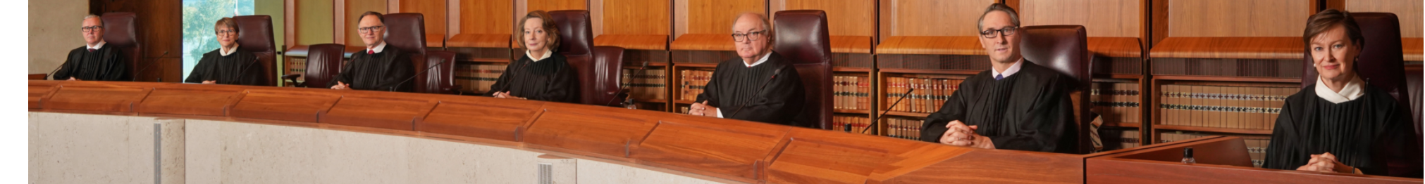
Diversity?

Slide 16
Role of the lawyer
Follow instructions
Maintain confidentiality
Avoid conflicts of interest
Communicate efficiently and in a timely manner
Act honestly and in your best interests
Act with skill and diligence

Slide 17
Parties in court
People involved in a court case. Applicants, appellants, respondents, defendants, are generally called ‘parties’.
plaintiff (the person or entity initiating the action)
defendant (the person or entity defending themselves/itself against the claims of the plaintiff).
In an appeal case the parties are referred to as appellant and respondent.
If the hearing is before a tribunal the parties are called the applicant and the respondent.

Slide 18
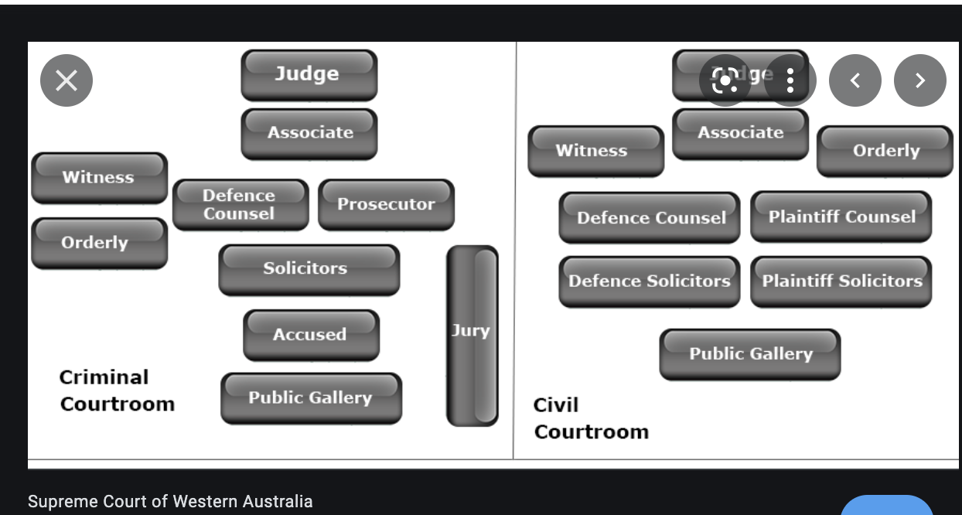
Court room

Slide 19
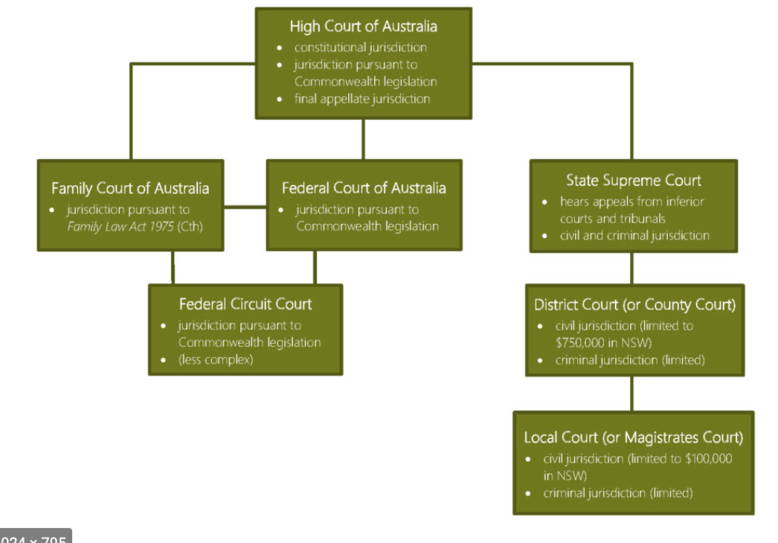
Federal court hierarchy

Slide 20
What is an appeal
For an appeal to succeed a party must convince the Court that the Judge that heard the original case made an error of law and that the error was of such significance that the decision should be overturned.
applied an incorrect principle of law; or
made a finding of fact or facts on an important issue which could not be supported by the evidence.
Court hearing the appeal:
does not consider any new evidence or information that was not presented in the original case (except in special circumstances);
• does not call witnesses to give evidence;
• does read all the relevant documents filed by the parties for the original case;
• does read the relevant parts of the transcript of the original case, if available;
• does listen to legal argument from both parties to the appeal

Slide 21
Adversarial model
winning and losing
Parties have responsibility for advocating their own case – emphasis on confrontation.
not ethically accountable for the client's goals.
judge is responsible for ensuring that the proceedings are conducted fairly.
Judge is not responsible for discovering the truth
Lawyer’s role is strictly partisan.
excessive costs and delays, overservicing, lack of accountability and unduly confrontational

Slide 22
Barriers to justice
Costs
lawyer/barrister fees and (for litigious matters) court fees, incidental costs?
Seven Network Limited v News Limited [2007] FCA 1062
Costs indemnity rule: losing party pays successful party’s costs on a party/party basis
Party / party basis: costs regarded as what is ‘reasonably necessary’ - not everything that lawyer has charged.

Slide 23
Barriers to justice
Formalities
Dress wigs/gowns
Language
Arrangement of the court
Box/witness stand
Cultural homogeneity

Slide 24
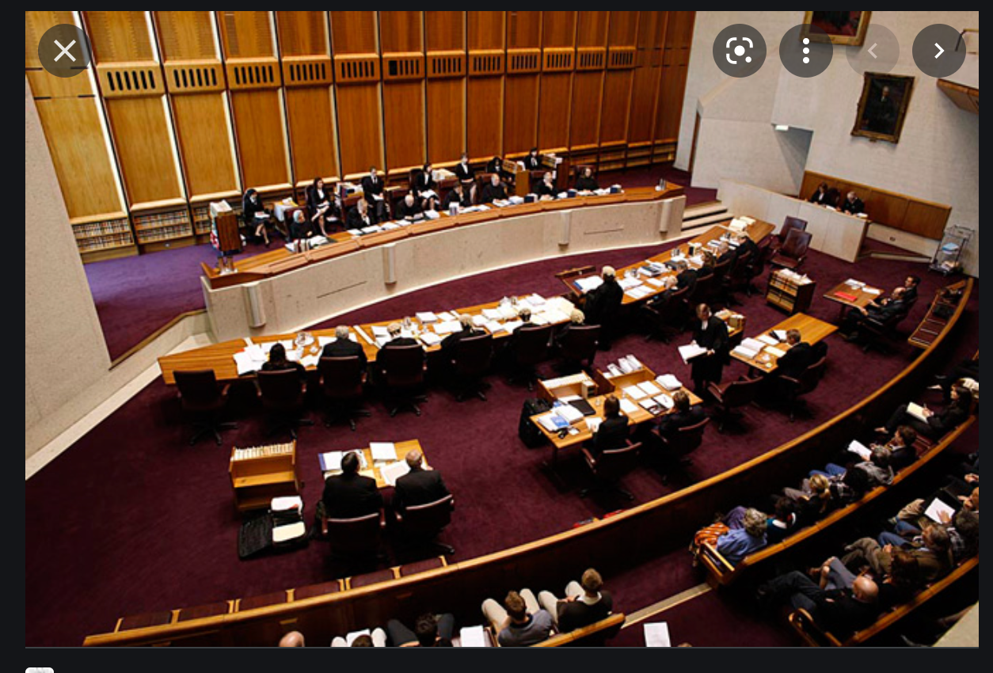
Formality

Slide 25
Self-represented litigants
Australian judicial system is adversarial in nature and depends on parties being able to effectively present their case. Parties have the right to self-represent in all Australian courts and “a central principle of the rule of law is that all parties involved in legal proceedings receive procedural fairness and access to justice.”. The increasing numbers of SRLs before our courts and tribunals place decision makers in a difficult position, having to balance the duty to remain impartial with the duty to afford procedural fairness to SRLs to ensure a fair trial.

